Slide 1
CluedIn Fundamentals: Ingesting a CSV file
Bring your data into CluedIn as-is, no upfront modelling required

Slide 2
Start to implement the training use case
Learn how to access the CluedIn platform
Training agenda
Review a few key prerequisites to get started
Start working with basic data ingestion in CluedIn

Slide 3


Practical use case
Creating a single source of truth for customer data by integrating information from two primary systems:
You’ll see how CluedIn enables seamless data ingestion, unification, and enrichment to provide a consistent and trustworthy customer view.
CRM
ERP

Slide 4
Before we begin
To get the most out of this training, please ensure:
01
CluedIn is installed and accessible
02
You’ve reviewed the setup steps in our documentation portal
You are using an OrganizationAdmin role with full permissions to perform the actions demonstrated during training
03
Having the right access will allow you to follow along and replicate the steps confidently.

Slide 5
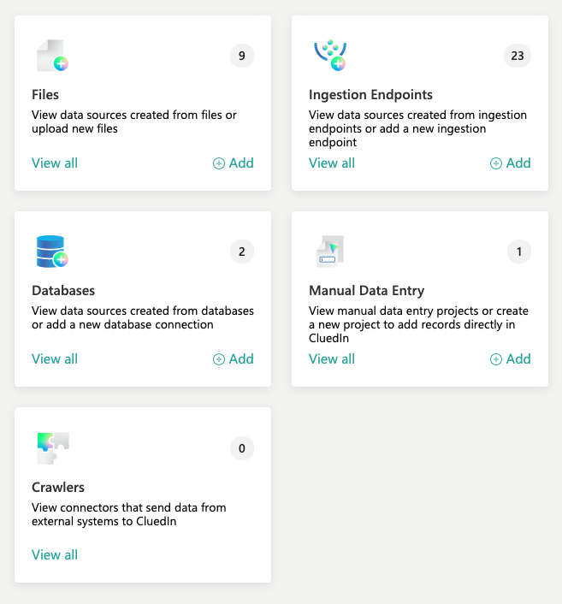
The easiest way to ingest data into CluedIn is by following three simple steps:
Import a file
Create mapping
How to ingest data into CluedIn?
Process data
This results in the creation of golden records-consolidated, accurate, and reliable representations of your data subjects.

Slide 6
DEMO: Ingesting CRM customer data
from a CSV file

Slide 7
Demo summary
You’ve seen how to:
Upload a CSV file into CluedIn
Map original fields to standardized fields
Process the data to generate golden records
Outcome:
Initial golden records created from the CRM system.
Next step:
Pause the video and upload the training file into CluedIn to replicate the process.

Slide 8
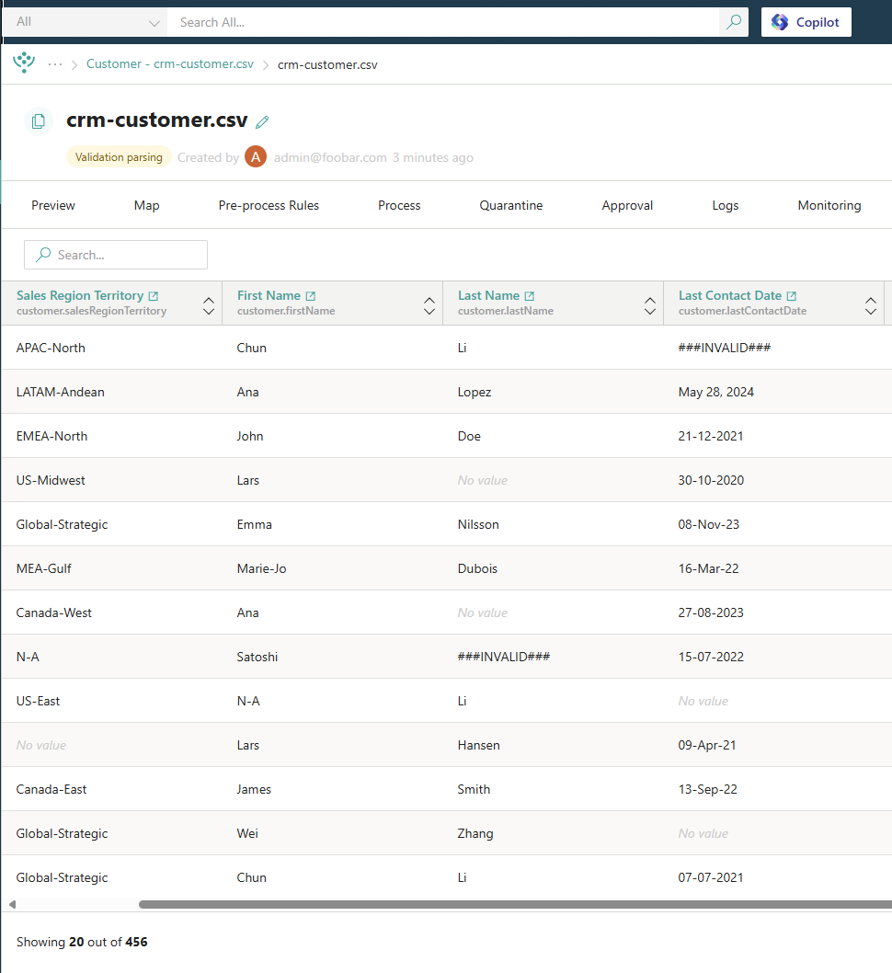


Learn more about data ingestion in our documentation portal.
Next session: Ingesting a database table representing ERP data.
What’s next?

